Slide 1




Cohort definition and creation
Anna Saura-Lazaro
OHDSI UK: 4th Annual Meeting: Training Day – Clinical Phenotyping
17th September 2026

Slide 2
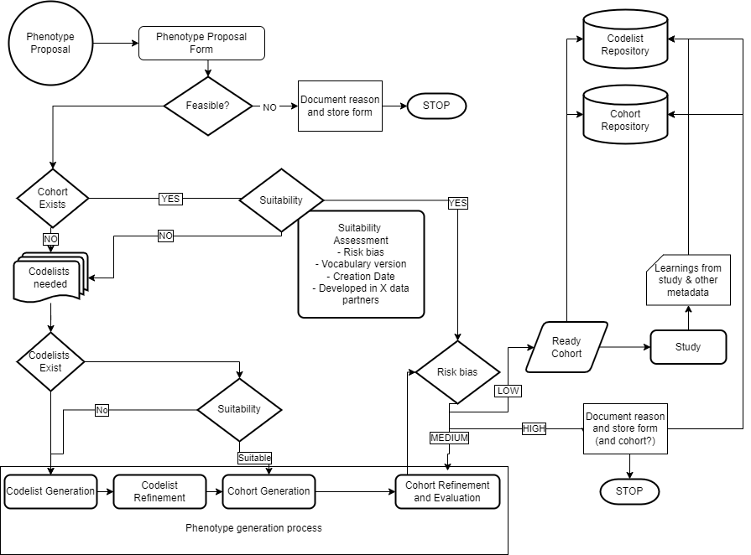
Phenotyping process
1. PROPOSAL
14 steps
2. PHENOTYPE EXISTS?
7 phases
7. STORAGE
3. CLINICAL DESCRIPTION
5. COHORT DEFINITION & CREATION
Risk of
misclassification
4. CODE LIST GENERATION
6. PHENOTYPE EVALUATION
Real World Evidence using the OMOP Common Data Model
OHDSI UK: 4th Annual Meeting: Training Day – Clinical Phenotyping

Slide 3
Phenotyping process
1. PROPOSAL
14 steps
2. PHENOTYPE EXISTS?
7 phases
7. STORAGE
3. CLINICAL DESCRIPTION
5. COHORT DEFINITION & CREATION
Risk of
misclassification
4. CODE LIST GENERATION
6. PHENOTYPE EVALUATION
Real World Evidence using the OMOP Common Data Model
OHDSI UK: 4th Annual Meeting: Training Day – Clinical Phenotyping

Slide 4
Definition of cohort
Cohort = a set of persons who satisfy one or more inclusion criteria for a duration of time
Cohort era = a continuous period during which a person has satisfied a cohort’s inclusion criteria
Cohort definition = the specification for how to identify a cohort
OHDSI UK: 4th Annual Meeting: Training Day – Clinical Phenotyping

Slide 5
Defining cohort definition components
Domain: A Domain defines the set of allowable Concepts for the standardized fields in the CDM tables.
  Ex: Condition, Drug, Procedure, Measurement
Concept set: An expression that defines one or more concepts encompassing a clinical entity of interest
  Ex: Concepts for Type 2 Diabetes Mellitus (T2DM), concepts for antidiabetic drugs, concepts for Hemoglobin A1C
Temporal logic: the time intervals within which the relationship between an inclusion criteria and an event is evaluated
  Ex: Indicated condition must occur during 365d prior to or on exposure start
OHDSI UK: 4th Annual Meeting: Training Day – Clinical Phenotyping

Slide 6
What initial event(s) define cohort entry?
Do:
  Define by existence of any observation in any domain
Don’t:
  Define by absence of an observation - when does absence occur?
  Define by age - year of birth is constant, but requires index date to anchor age calculation
Caution:
  Defining a cohort by calendar date can cause observation bias, since that date unlikely to be at point of health service utilization, ex: cases matched to controls. Consider instead defining by a visit that occurs within a calendar timeframe.
OHDSI UK: 4th Annual Meeting: Training Day – Clinical Phenotyping

Slide 7
What inclusion criteria are applied to the initial events?
Do:
  Clearly define inclusion and exclusion criteria, and document the logic used to combine them.
  Use information on or before index event
  (think like a randomized trial: index event is study start, can’t predict future)
Don’t:
  Assume temporal logic, but always provide relative time window to evaluate criteria
Caution:
  One person may have multiple initial events, criteria are applied to each event (not person)
OHDSI UK: 4th Annual Meeting: Training Day – Clinical Phenotyping

Slide 8
What defines a person’s cohort exit?
Do:
  Specify a cohort exit, even if you are not intending to use it for your analytic use case
Don’t:
  Confuse censoring for analytical purposes with cohort definition (which can be analysis-independent)…ex: censoring at time of outcome
Caution:
  Time a person is in the cohort is not always the same as the time we use in the analysis. In some studies, we may only look at a short period after an exposure, while in others we may follow patients for their entire observation period.
OHDSI UK: 4th Annual Meeting: Training Day – Clinical Phenotyping

Slide 9
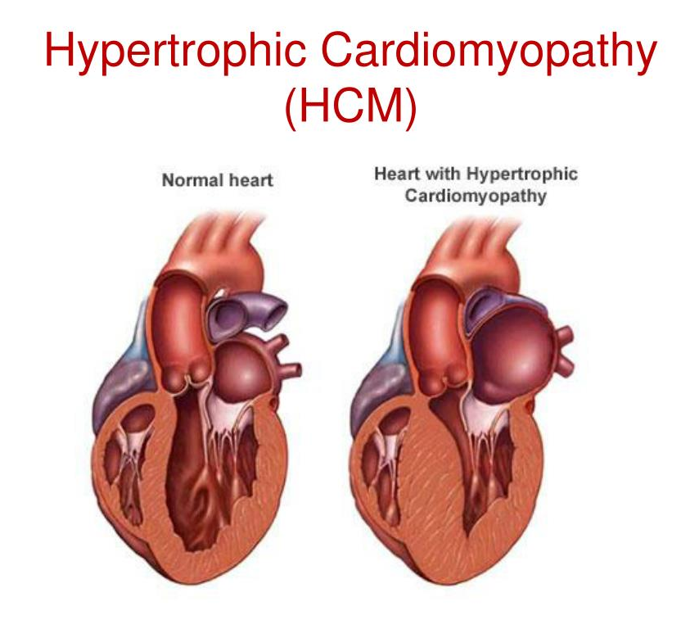
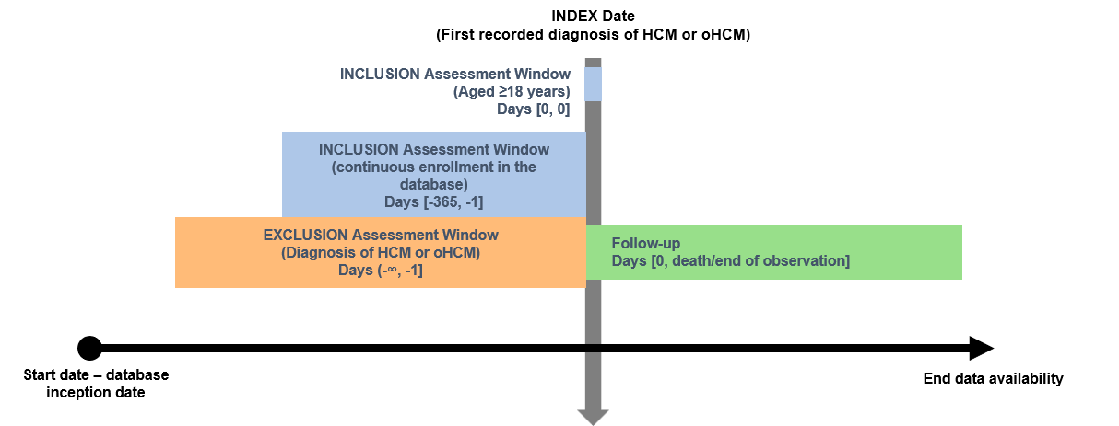
Cohort definition: an example
OHDSI UK: 4th Annual Meeting: Training Day – Clinical Phenotyping

Slide 10
Key considerations when defining a cohort
OHDSI UK: 4th Annual Meeting: Training Day – Clinical Phenotyping

Slide 11
Key considerations when defining a cohort
Are we finding enough cases?
Are they really cases?
Sensitivity
Specificity
Broad concept sets
Multiple domains (conditions, drugs, procedures)
Reduces missed cases
Restrictive concept sets
Additional inclusion criteria
Higher confidence in case identification
⚠️ Too much sensitivity may include false positives
⚠️ Too much specificity may exclude true cases
OHDSI UK: 4th Annual Meeting: Training Day – Clinical Phenotyping

Slide 12
Key considerations when defining a cohort
Are we finding enough cases?
Are they really cases?
Sensitivity
Specificity
Broad concept sets
Multiple domains (conditions, drugs, procedures)
Reduces missed cases
Restrictive concept sets
Additional inclusion criteria
Higher confidence in case identification
⚠️ Too much sensitivity may include false positives
⚠️ Too much specificity may exclude true cases
OHDSI UK: 4th Annual Meeting: Training Day – Clinical Phenotyping

Slide 13
Key considerations when defining a cohort
Are we finding enough cases?
Are they really cases?
Are we identifying them at the right time?
Sensitivity
Specificity
Index date definition
Broad concept sets
Multiple domains (conditions, drugs, procedures)
Reduces missed cases
Restrictive concept sets
Additional inclusion criteria
Higher confidence in case identification
Delayed diagnosis
Delayed coding
Treatment before diagnosis
Symptoms before diagnosis
⚠️ Too much sensitivity may include false positives
⚠️ Too much specificity may exclude true cases
⚠️ Misclassified index dates can bias follow-up and baseline assessments
OHDSI UK: 4th Annual Meeting: Training Day – Clinical Phenotyping

Slide 14
Choosing the right index date
The index date determines:
Who enters the cohort
Baseline covariates
Washout periods
Follow-up start
Outcome timing
OHDSI UK: 4th Annual Meeting: Training Day – Clinical Phenotyping

Slide 15
Choosing the right index date
The index date determines:
Who enters the cohort
Baseline covariates
Washout periods
Follow-up start
Outcome timing
True Heart Failure Onset
↓
Symptoms Treatment started Diagnosis recorded
●------------------●--------------------------●-------------------------------…
Jan March Sep
OHDSI UK: 4th Annual Meeting: Training Day – Clinical Phenotyping

Slide 16
Choosing the right index date
The index date determines:
Who enters the cohort
Baseline covariates
Washout periods
Follow-up start
Outcome timing
True Heart Failure Onset
↓
Symptoms Treatment started Diagnosis recorded
●------------------●--------------------------●-------------------------------…
Jan March Sep
↑
Index date
←------ Misclassified period--------→
⚠️ The first recorded diagnosis may not represent the true start of disease
OHDSI UK: 4th Annual Meeting: Training Day – Clinical Phenotyping

Slide 17
Index date misclassification
Common causes
Delayed diagnosis
Delayed coding
Treatment initiated before diagnosis
Disease present before database entry
Consequences
Incident cases classified as new when actually prevalent
Incorrect disease duration
Misclassified baseline covariates
Biased risk estimates
OHDSI UK: 4th Annual Meeting: Training Day – Clinical Phenotyping

Slide 18

Index date misclassification
Common causes
Delayed diagnosis
Delayed coding
Treatment initiated before diagnosis
Disease present before database entry
Consequences
Incident cases classified as new when actually prevalent
Incorrect disease duration
Misclassified baseline covariates
Biased risk estimates
Prior observation period → ≥365 days prior history
Multiple domains
Alternative index definitions → diagnosis vs treatment initiation
Sensitivity analyses
Transparent reporting
OHDSI UK: 4th Annual Meeting: Training Day – Clinical Phenotyping

Slide 19
Which index date would you choose?
Case study: Heart Failure
Question
For a study of heart failure prognosis, what should the index date be?
A. First symptom (January)
B. Treatment initiation (June)
C. Diagnosis recorded date (September)
D. Depends on the study question
OHDSI UK: 4th Annual Meeting: Training Day – Clinical Phenotyping

Slide 20
Which index date would you choose?
Case study: Heart Failure
Question
For a study of heart failure prognosis, what should the index date be?
A. First symptom (January)
B. Treatment initiation (June)
C. Diagnosis recorded date (September)
D. Depends on the study question
Studying natural history of HF?
→ Earliest evidence of disease (symptoms)
Studying treatment effectiveness?
→ Treatment initiation
Studying diagnostic pathways?
→ Diagnosis date
Studying prognosis after diagnosis?
→ Diagnosis date may be appropriate
OHDSI UK: 4th Annual Meeting: Training Day – Clinical Phenotyping

Slide 21
Index date: a design choice, not a rule
There is rarely a single "correct" index date.
The most appropriate index date depends on the research question and study objective.
Index date misclassification should be considered, evaluated, and transparently reported during phenotype and cohort development.
In causal studies, thoughtful design choices (e.g., new-user designs, matching/adjustment, and sensitivity analyses) can help reduce bias arising from index date misclassification.
Understanding the potential impact of index date misclassification is often more important than finding a perfect index date.
OHDSI UK: 4th Annual Meeting: Training Day – Clinical Phenotyping

Slide 22
Cohort creation
OHDSI UK: 4th Annual Meeting: Training Day – Clinical Phenotyping

Slide 23
Cohort creation
Tools:
- ATLAS
- CohortConstructor
OHDSI UK: 4th Annual Meeting: Training Day – Clinical Phenotyping

Slide 24
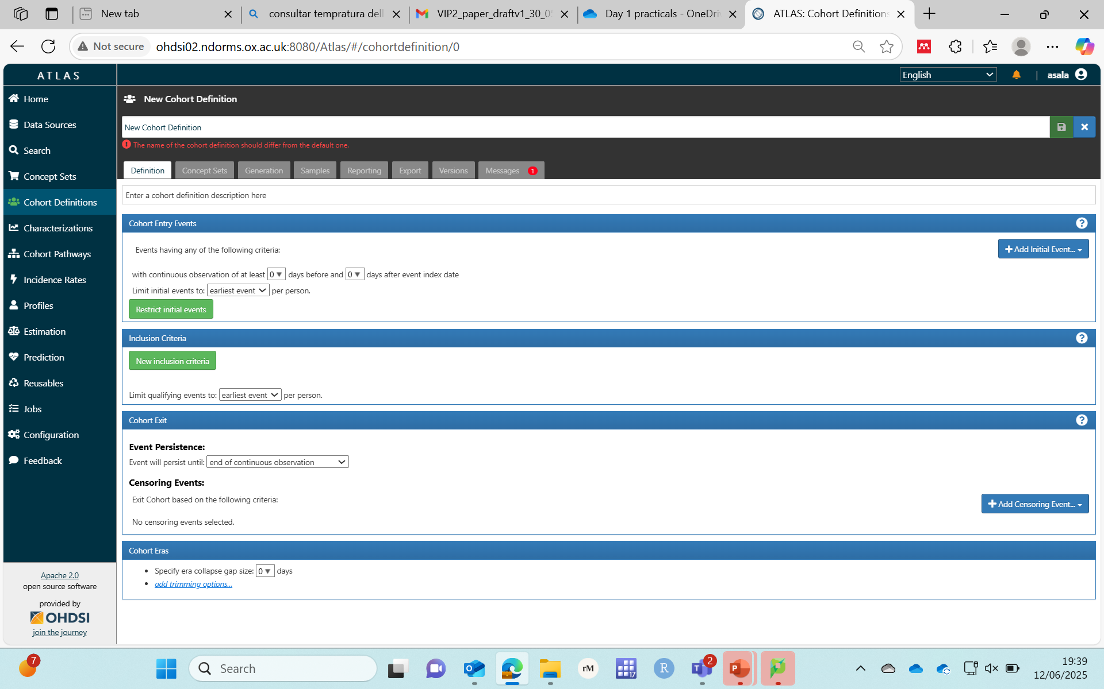
ATLAS
Cohort creation

Slide 25
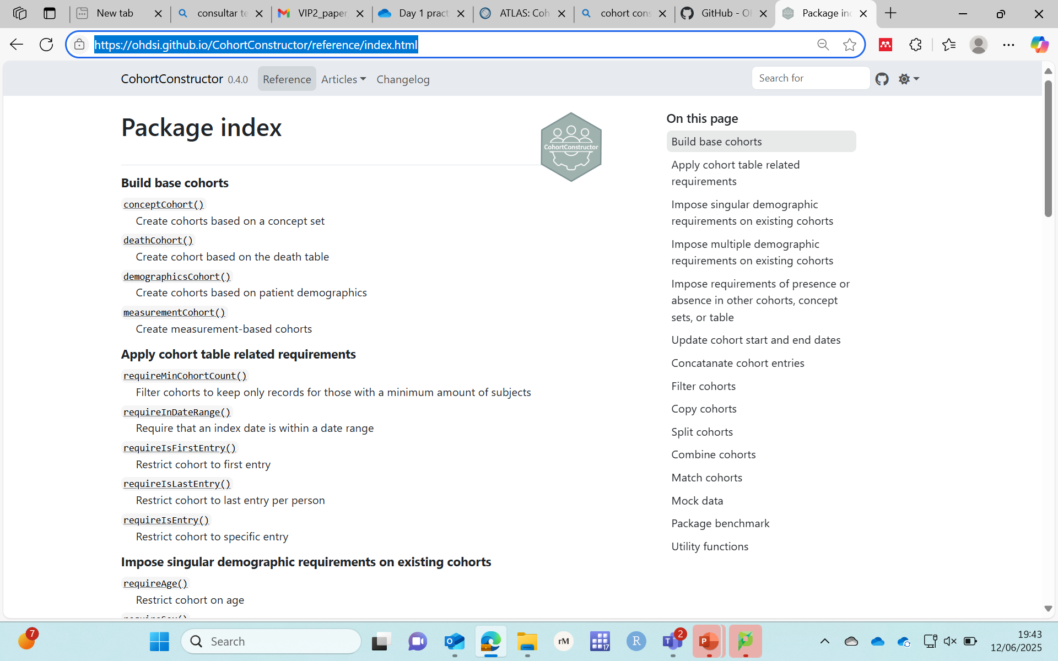

Cohort creation
Package index • CohortConstructor

Slide 26

OHDSI UK: 4th Annual Meeting: Training Day – Clinical Phenotyping

Slide 27
Breakout Session
Design a cohort definition to answer the assigned research question
Define:
Cohort entry (index date)
Inclusion criteria
Exclusion criteria
Cohort exit
Required code lists/concept sets
Potential sources of misclassification (sensitivity, specificity, index date)
OHDSI UK: 4th Annual Meeting: Training Day – Clinical Phenotyping

Slide 28
Research questions
What is long-term risk of stroke in patients with atrial fibrillation and hypertension?
Among patients with hypertension, what is the 5-year risk of heart failure after initiating ACE inhibitors?
What is the risk of developing heart failure in patients with acute pericarditis?
What is the 1-year mortality rate for patients diagnosed with myocardial infarction?
OHDSI UK: 4th Annual Meeting: Training Day – Clinical Phenotyping

Slide 29

Q&A
Anna Saura-Lazaro
anna.sauralazaro@ndorms.ox.ac.uk
OHDSI UK: 4th Annual Meeting: Training Day – Clinical Phenotyping

Slide 30

What’s the next step after finalising your code lists/concept sets?
A. Review cohort diagnostics to check if the concept sets perform as expected.
B. Stop here—concept sets are all you need.
C. Ask someone else to figure it out.
D. Define the cohort logic and build it using tools such as ATLAS or CohortConstructor.

Slide 31
What’s the next step after finalising your code lists/concept sets?
A. Review cohort diagnostics to check if the concept sets perform as expected.
B. Stop here—concept sets are all you need.
C. Ask someone else to figure it out.
D. Define the cohort logic and build it using tools such as CohortConstructor or ATLAS.

